Slide 1
Part 1

Slide 2

Starter activity
Passwords
1
2
3
from data import passwords
password = passwords[0 ]
print("Most common password")
Assume that passwords is a list of common passwords, sorted according to popularity: the more common passwords are earlier in the list.
Note The data module and the passwords list are not standard Python components.
Question .
Fill in the gap with an index, so that the program displays the most common password.

Slide 3
Starter activity
Passwords
1
2
3
4
5
6
7
from data import passwords
password = passwords[0]
print("Most common password")
password = passwords[1 ]
print("2nd most common password")
password = passwords[9 ]
print("10th most common password")
Assume that passwords is a list of common passwords, sorted according to popularity: the more common passwords are earlier in the list.
Question .
Fill in the gaps so that the program also displays the second and tenth most common passwords.

Slide 4
Starter activity
Passwords
1
2
3
from data import passwords
nb_passwords = len(passwords)
print(nb_passwords)
Assume that passwords is a list of common passwords, sorted according to popularity: the more common passwords are earlier in the list.
Question .
Fill in the gap so that the program displays the number of passwords contained in the list.

Slide 5
Starter activity
Passwords
1
2
3
4
5
6
7
from data import passwords
print("Password to check:")
password = input()
if password in passwords:
print("Common password")
else:
print("Not a common password")
Assume that passwords is a list of common passwords, sorted according to popularity: the more common passwords are earlier in the list.
Question .
Fill in the gap with a condition that checks if the list of passwords contains an item equal to password.
passwords[index] == password
passwords.index(password) >= 0
password in passwords
password < len(passwords)
▹

Slide 6
Starter activity
Passwords
1
2
3
4
5
6
7
8
9
from data import passwords
print("Password to check:")
password = input()
if password in passwords:
print("Common password")
rank = passwords.index(password)
print("Popularity", rank)
else:
print("Not a common password")
Assume that passwords is a list of common passwords, sorted according to popularity: the more common passwords are earlier in the list.
Question . How popular is this password?
Fill in the gap so that rank is the position of password in the list of passwords.
passwords[index]
passwords.index(password)
password in passwords
len(password)
▹

Slide 7
Starter activity
Passwords
1
2
3
4
5
6
7
8
9
10
from data import passwords
password = input("Password to check: ")
if password in passwords:
print("Common password")
rank = passwords.index(password)
print("Popularity", rank)
else:
print("Not a common password")
Open this program in your development environment (ncce.io/py-passwords-1)
Run it and test different passwords!
Note The data module and the passwords list are not standard Python components.
.

Slide 8

Objectives
In this lesson, you will...
Use iteration (while statements) to control the flow of program execution
Practise using common operations on lists
Perform operations on strings

Slide 9
Activity 1
Form a band
1
2
3
4
5
6
print("Let's form a band")
band = []
print("Pick an instrument:")
instrument = input()
band.append(instrument)
print(band)
This program reads the name of an instrument and adds it to a list.
This action needs to be performed repeatedly, in order to add all the instruments required to form a band.

Slide 10
Activity 1
Form a band
1
2
3
4
5
6
7
8
9
10
11
12
print("Let's form a band")
band = []
print("Pick an instrument:")
instrument = input()
band.append(instrument)
print("Pick an instrument:")
instrument = input()
band.append(instrument)
print("Pick an instrument:")
instrument = input()
band.append(instrument)
print(band)
This approach won’t get us far.
How can we get our programs to perform actions repeatedly?

Slide 11

Activity 1
Iteration recap
while :
You need an iterative structure . (while) when your program needs to repeat actions, while a condition is satisfied.
condition
block of statements

Slide 12

Activity 1
Form a band
1
2
3
4
5
6
print("Let's form a band")
band = []
print("Pick an instrument:")
instrument = input()
band.append(instrument)
print(band)
Let’s modify this program together to use iteration (a while-loop), in order to repeat the same actions.
Live coding (ncce.io/py-band-0)

Slide 13
Activity 1
Form a band: After the live coding session
1
2
3
4
5
6
7
print("Let's form a band")
band = []
while len(band) < 3:
print("Pick an instrument:")
instrument = input()
band.append(instrument)
print(band)
We created a program that uses iteration (a while-loop) in order to repeatedly read the names of instruments and add them to a list.
In this case, the process is repeated for as long as the length of the list has not reached 3.

Slide 14
Activity 1
Form a band: After the live coding session
1
2
3
4
5
6
7
print("Let's form a band")
band = []
while not "guitar" in band:
print("Pick an instrument:")
instrument = input()
band.append(instrument)
print(band)
We created a program that uses iteration (a while-loop) in order to repeatedly read the names of instruments and add them to a list.
In this case, the process is repeated for as long as the the list does not contain a guitar!

Slide 15
Activity 1
Form a band: Walkthrough
1
2
3
4
5
6
7
print("Let's form a band")
band = []
while "guitar" not in band:
print("Pick an instrument:")
instrument = input()
band.append(instrument)
print(band)
State .
Input/Output .
Let's form a band

Slide 16
Activity 1
Form a band: Walkthrough
1
2
3
4
5
6
7
print("Let's form a band")
band = []
while "guitar" not in band:
print("Pick an instrument:")
instrument = input()
band.append(instrument)
print(band)
State .
band
True
Input/Output .
Pick an instrument:
User types violin

Slide 17
Activity 1
Form a band: Walkthrough
1
2
3
4
5
6
7
print("Let's form a band")
band = []
while "guitar" not in band:
print("Pick an instrument:")
instrument = input()
band.append(instrument)
print(band)
State .
band
instrument
"violin"
Input/Output .
Pick an instrument:
User types violin

Slide 18
Activity 1
Form a band: Walkthrough
1
2
3
4
5
6
7
print("Let's form a band")
band = []
while "guitar" not in band:
print("Pick an instrument:")
instrument = input()
band.append(instrument)
print(band)
State .
band
instrument
True
0 | "violin"
"violin"
Input/Output .
Pick an instrument:
User types bass

Slide 19
Activity 1
Form a band: Walkthrough
1
2
3
4
5
6
7
print("Let's form a band")
band = []
while "guitar" not in band:
print("Pick an instrument:")
instrument = input()
band.append(instrument)
print(band)
State .
band
instrument
0 | "violin"
"bass"
Input/Output .
Pick an instrument:
User types bass

Slide 20
Activity 1
Form a band: Walkthrough
1
2
3
4
5
6
7
print("Let's form a band")
band = []
while "guitar" not in band:
print("Pick an instrument:")
instrument = input()
band.append(instrument)
print(band)
State .
band
instrument
True
0 | "violin"
1 | "bass"
"bass"
Input/Output .
Pick an instrument:
User types guitar

Slide 21
Activity 1
Form a band: Walkthrough
1
2
3
4
5
6
7
print("Let's form a band")
band = []
while "guitar" not in band:
print("Pick an instrument:")
instrument = input()
band.append(instrument)
print(band)
State .
band
instrument
0 | "violin"
1 | "bass"
"guitar"
Input/Output .
Pick an instrument:
User types guitar

Slide 22
Activity 1
Form a band: Walkthrough
1
2
3
4
5
6
7
print("Let's form a band")
band = []
while "guitar" not in band:
print("Pick an instrument:")
instrument = input()
band.append(instrument)
print(band)
State .
band
instrument
False
0 | "violin"
1 | "bass"
2 | "guitar"
"guitar"
Input/Output .
["violin", "bass", "guitar"]

Slide 23

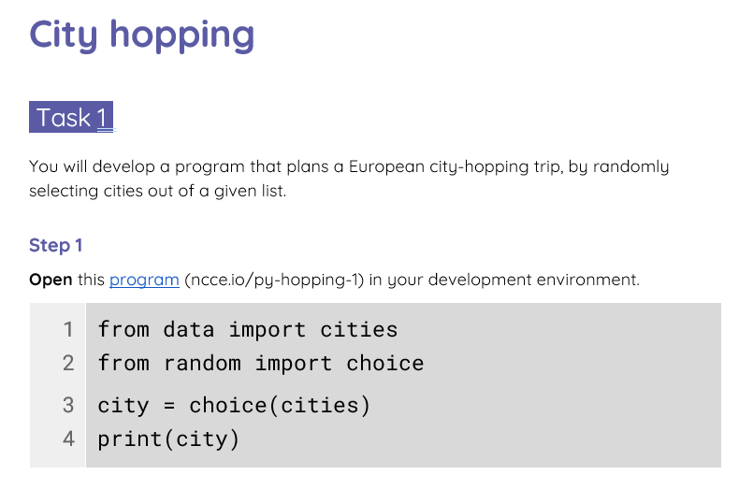
Activity 2
City hopping
Complete the task on your worksheet to create a random-trip planner.

Slide 24

Activity 2
City hopping: Solutions
1
2
3
4
5
6
7
8
from data import cities
from random import choice
print("City hopping random planner")
trip = []
while len(trip) < 5:
city = choice(cities)
trip.append(city)
print("Itinerary:", trip)
Randomly select a city from the list of cities.
Add this city to the end of the trip list.

Slide 25
Activity 2
City hopping: Solutions
1
2
3
4
5
6
7
8
9
from data import cities
from random import choice
print("City hopping random planner")
trip = []
while len(trip) < 5:
city = choice(cities)
trip.append(city)
cities.remove(city)
print("Itinerary:", trip)
Remove the city from the list of cities, so it cannot be selected again.

Slide 26
Activity 2
City hopping: Solutions
1
2
3
4
5
6
7
8
9
10
from data import cities
from random import choice
print("City hopping random planner")
trip = []
while "London" not in trip:
city = choice(cities)
trip.append(city)
cities.remove(city)
trip.insert(0, "London")
print("Itinerary:", trip)
Modify the condition: these actions are repeated for as long as London has not been included in the trip.
In the end, London is also inserted as the first item in the trip list.

Slide 27
Activity 3
Strings (are a lot like lists)
The built-in len function returns the length (number of items) of a list.
Syntax len(list)
The len function returns the length (number of characters) of a string.
Syntax len(string)
Example
numbers = [16, 76, 11]
length = len(numbers)
Example
language = "Python"
length = len(language)
3
6

Slide 28
Activity 3
Strings (are a lot like lists)
The in operator checks if a value is equal to any item in a list.
Expressions formed with in evaluate to either True or False.
Syntax item in list
The in operator checks if a string is contained within another string.
Expressions formed with in evaluate to either True or False.
Syntax string in string
Example
numbers = [16, 76, 11]
found = 32 in numbers
Example
language = "Python"
contains = "ty" in language
check = language in "pythonic"
False
False
False

Slide 29
Activity 3
Strings (are a lot like lists)
An item in a list can be accessed through its index.
Syntax list[index]
A character in a string can be accessed through its index.
Syntax string[index]
Example
numbers = [16, 76, 11]
item = numbers[1]
numbers[2] = 32
Example
language = "Python"
character = language[1]
Caution: You cannot assign a new value to an individual character in a string.
language[0] = ‘p’
76
"y"

Slide 30
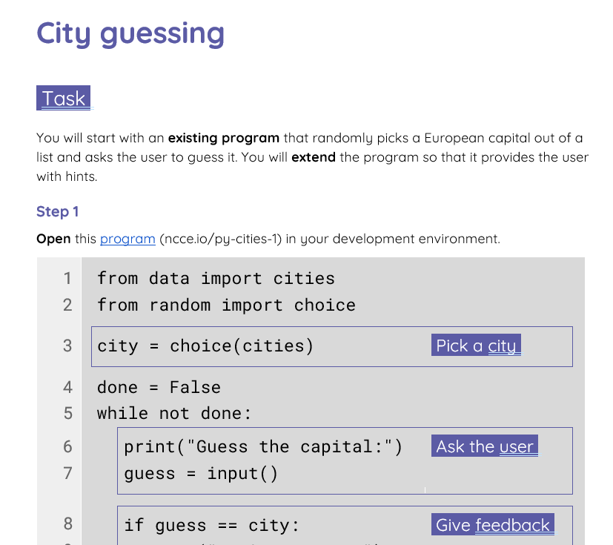
Activity 3
City guessing
Start with a program that uses the familiar list of European cities and complete the task on your worksheet to extend it into a city guessing game with hints.

Slide 31
Activity 3
City guessing: Starting point
4
5
6
7
8
9
10
11
12
13
14
15
done = False
while done == False:
print("Guess the capital:")
guess = input()
if guess == city:
print("You've got it!")
done = True
elif guess == "":
print("It was", city)
done = True
else:
print("Try again")
Ask the user .
Give feedback .

Slide 32
Activity 3
City guessing: Solutions
Hint: First letter of city
11
12
13
14
15
16
17
18
elif city[0] != guess[0]:
print("The first letter is", city[0])
elif len(guess) != len(city):
print("It has", len(city), "letters")
elif city[1] not in guess:
print("It contains letter", city[1])
else:
print("Try again")
Hint: Length of city
Hint: Additional letter contained in city

Slide 33
Summary
In this lesson, you...
In the next lesson, you will...
Used iteration (while statements) to control the flow of program execution
Practised using common operations on lists
Performed operations on strings
Use iteration (for statements) to iterate over list items
Practise using common operations lists and strings

Slide 34
Part 2

Slide 35
Starter activity
Shopping list
1
2
3
4
5
6
shopping = ["Pasta", "Tomatoes",
"Onions", "Basil",
"Parmesan"]
print("Buy:")
for item in shopping:
print(item)
This is a shopping list.
Question .
What do you think will be displayed on the screen when this program is executed?
Buy:
Pasta
Tomatoes
Onions
Basil
Parmesan

Slide 36

Starter activity
for loops: Syntax and use
for in :
for loops are convenient for iterating over the items of a list
variable
list
block of statements
Note for loops can be used for iterating over any sequence of elements, e.g. strings.

Slide 37
Objectives
In this lesson, you will...
Use iteration (for statements) to iterate over list items
Practise using common operations on lists and strings

Slide 38
Activity 1
Iterating over a list of dice rolls
1
2
3
rolls = [1, 4, 3, 6]
for dice in rolls:
print(dice)
This is a list of dice rolls.
Question .
What do you think will be displayed on the screen when this program is executed?
1
4
3
6

Slide 39
Activity 1
Iterating over a list of dice rolls
1
2
3
4
5
rolls = [1, 4, 3, 6]
count = 0
for dice in rolls:
count = count + 1
print(count)
This is a list of dice rolls.
Question .
What do you think will be displayed on the screen when this program is executed?
4
The count variable is initialised to 0 and is incremented by 1 for each item in the list.

Slide 40
Activity 1
Iterating over a list of dice rolls
1
2
3
4
5
6
rolls = [1, 4, 3, 6]
count = 0
for dice in rolls:
if dice > 3:
count = count + 1
print(count)
This is a list of dice rolls.
Question .
What do you think will be displayed on the screen when this program is executed?
2
The count variable is initialised to 0 and is incremented by 1 for each item in the list that is greater than 3.

Slide 41
Activity 1
Iterating over a list of dice rolls
1
2
3
4
5
6
rolls = [1, 4, 3, 6]
selection = []
for dice in rolls:
if dice > 3:
selection.append(dice)
print(selection)
This is a list of dice rolls.
Question .
What do you think will be displayed on the screen when this program is executed?
[4, 6]
selection is initialised to an empty list [].
The value of each dice roll in rolls that is greater than 3 is appended to selection.

Slide 42
Activity 1
Iterating over a list of dice rolls: Walkthrough
1
2
3
4
5
6
rolls = [1, 4, 3, 6]
selection = []
for dice in rolls:
if dice > 3:
selection.append(dice)
print(selection)
State .
rolls
0 | 1
1 | 4
2 | 3
3 | 6
selection

Slide 43
Activity 1
Iterating over a list of dice rolls: Walkthrough
1
2
3
4
5
6
rolls = [1, 4, 3, 6]
selection = []
for dice in rolls:
if dice > 3:
selection.append(dice)
print(selection)
State .
rolls
dice
0 | 1
1 | 4
2 | 3
3 | 6
1
False
selection

Slide 44
Activity 1
Iterating over a list of dice rolls: Walkthrough
1
2
3
4
5
6
rolls = [1, 4, 3, 6]
selection = []
for dice in rolls:
if dice > 3:
selection.append(dice)
print(selection)
State .
rolls
dice
0 | 1
1 | 4
2 | 3
3 | 6
4
True
selection

Slide 45
Activity 1
Iterating over a list of dice rolls: Walkthrough
1
2
3
4
5
6
rolls = [1, 4, 3, 6]
selection = []
for dice in rolls:
if dice > 3:
selection.append(dice)
print(selection)
State .
rolls
dice
0 | 1
1 | 4
2 | 3
3 | 6
4
selection
0 | 4

Slide 46
Activity 1
Iterating over a list of dice rolls: Walkthrough
1
2
3
4
5
6
rolls = [1, 4, 3, 6]
selection = []
for dice in rolls:
if dice > 3:
selection.append(dice)
print(selection)
State .
rolls
dice
0 | 1
1 | 4
2 | 3
3 | 6
3
False
selection
0 | 4

Slide 47
Activity 1
Iterating over a list of dice rolls: Walkthrough
1
2
3
4
5
6
rolls = [1, 4, 3, 6]
selection = []
for dice in rolls:
if dice > 3:
selection.append(dice)
print(selection)
State .
rolls
dice
0 | 1
1 | 4
2 | 3
3 | 6
6
True
selection
0 | 4

Slide 48
Activity 1
Iterating over a list of dice rolls: Walkthrough
1
2
3
4
5
6
rolls = [1, 4, 3, 6]
selection = []
for dice in rolls:
if dice > 3:
selection.append(dice)
print(selection)
State .
rolls
dice
0 | 1
1 | 4
2 | 3
3 | 6
6
selection
0 | 4
1 | 6

Slide 49
Activity 1
Iterating over a list of dice rolls: Walkthrough
1
2
3
4
5
6
rolls = [1, 4, 3, 6]
selection = []
for dice in rolls:
if dice > 3:
selection.append(dice)
print(selection)
State .
rolls
0 | 1
1 | 4
2 | 3
3 | 6
selection
0 | 4
1 | 6

Slide 50

Activity 2
You will be using pair programming , with each member in a pair taking on a specific role:
Driver
Control the keyboard and mouse
Navigator
Provide support and instructions
You will alternate between roles.

Slide 51
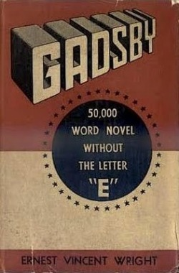
Activity 2
Lipogram
The 1939 novel Gadsby, by Ernest Vincent Wright is a lipogram (missing a letter).

Slide 52
Activity 2
Lipogram
A note at the end of the book claims: “Not a word containing the letter ‘E’ has appeared in this story of over 50,000 words.”
We will make a program to check this claim.

Slide 53
Activity 2
Lipogram
1
2
from textfile import words
wordlist = words('gadsby.txt')
This code retrieves the entire text of Gadsby and stores it as a list of words (wordlist).
Note The textfile module and the words function are not standard Python components.
We will make a program that checks the claim that no words containing ‘E’ are to be found in the book.
Live coding (ncce.io/py-books-2)

Slide 54
Activity 2
Lipogram: After the live coding session
1
2
3
4
5
6
7
from textfile import words
wordlist = words('gadsby.txt')
length = len(wordlist)
print(length, "words in Gadsby")
for word in wordlist:
if "e" in word:
print(word)
Determine the number of words in the book (the length of the wordlist).
Iterate over the wordlist and print any word that contains "e".

Slide 55
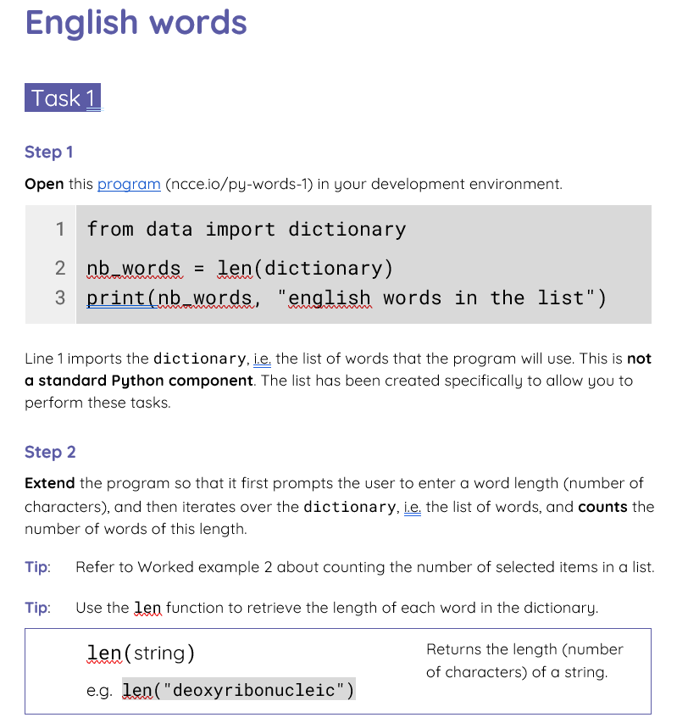
Activity 3
English words
Use for to iterate over a list containing thousands of English words, to complete the tasks from your worksheet.

Slide 56
Activity 3
English words: Task 1 solution
1
2
3
4
5
6
7
8
9
10
from data import dictionary
nb_words = len(dictionary)
print(nb_words, "english words in the list")
print("Length of words to search for:")
length = int(input())
count = 0
for word in dictionary:
if len(word) == length:
count = count + 1
print("There are", count, "words with", length, "letters")
Count words of a given length:
iterate over the en_words and increase the count when the length of the current word is equal to the given length.

Slide 57
Activity 3
English words: Task 2 solution
1
2
3
4
5
6
7
8
9
from data import dictionary
print("Text to search for:")
sub = input()
collection = []
for word in dictionary:
if sub in word:
collection.append(word)
for word in collection:
print(word)
Collect words that contain a given string: iterate over the en_words and append to the collection when the current word contains the given sub-string.
Print every word in the collection.

Slide 58
Activity 3
English words: Explorer task solution
1
2
3
4
5
6
from data import dictionary
longest = ""
for word in dictionary:
if len(word) > len(longest):
longest = word
print("The longest word is", longest)
The successive values of longest, as the program iterates over the words.
a
aa
aaa
aahed
aahing
aardvark
aardvarks
aardwolves
abacination
abalienating
abarticulation
abdominoanterior
abdominohysterectomy
acetylphenylhydrazine
alkylbenzenesulfonates
anthropomorphologically
antidisestablishmentarian
antidisestablishmentarianism
cyclotrimethylenetrinitramine
dichlorodiphenyltrichloroethane (31 letters)

Slide 59

Activity 4
Heartbeats
So far, you have used for to iterate over lists of textual data.
In this activity, you will iterate over lists of numbers.

Slide 60
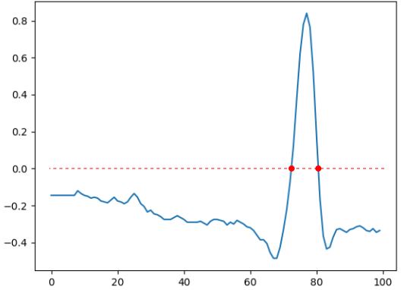
Activity 4
Heartbeats
Use your worksheet to process real ECG (electrocardiogram) data from a medical database, to detect heartbeats.

Slide 61
Activity 4
Heartbeats: Solutions
1
2
3
4
5
from mitdb_data import load, plot
heartbeat_data = load(1000)
plot(heartbeat_data, 'heartbeats.png')
previous = -1.0
for value in heartbeat_data:
previous = value
Print "heartbeat detected"
every time value is positive and
its previous value is negative.
Assign the current value to previous.
In the next iteration, value will be updated, but previous will hold its value from the current iteration.

Slide 62
Activity 4
Heartbeats: Solutions
1
2
3
4
5
6
7
8
9
from mitdb_data import load, plot
heartbeat_data = load(1000)
plot(heartbeat_data, 'heartbeats.png')
previous = -1.0
for value in heartbeat_data:
if value > 0:
if previous < 0:
print("heartbeat detected")
previous = value
Assign the current value to previous.
In the next iteration, value will be updated, but previous will hold its value from the current iteration.

Slide 63
Activity 4
Heartbeats: Solutions
1
2
3
4
5
6
7
8
from mitdb_data import load, plot
heartbeat_data = load(1000)
plot(heartbeat_data, 'heartbeats.png')
previous = -1.0
for value in heartbeat_data:
if value > 0 and previous < 0:
print("heartbeat detected")
previous = value
Assign the current value to previous.
In the next iteration, value will be updated, but previous will hold its value from the current iteration.

Slide 64
Activity 4
Heartbeats: Solutions
1
2
3
4
5
6
7
8
9
10
11
from mitdb_data import load, plot
mins = 15
heartbeat_data = load(mins*60*360)
count = 0
previous = -1.0
for value in heartbeat_data:
if value > 0 and previous < 0:
count = count + 1
previous = value
print(count, "heartbeats detected")
print("average heart rate is", count/mins)
15-minutes worth of data,
at 360 values per second

Slide 65
Plenary
What’s this for?
1
2
3
word = "lipogram"
for item in word:
print(item)
Question .
What do you think will be displayed on the screen when this program is executed?
l
i
p
o
g
r
a
m
Note . You can use for to iterate over anything that has individual elements.
In this case, for iterates over the characters of a string.

Slide 66
Plenary
What’s this for?
1
2
3
4
syllables = ["li", "po", "gram"]
for syllable in syllables:
for letter in syllable:
print(letter)
Explorer task .
What do you think will be displayed on the screen when this program is executed?
l
i
p
o
g
r
a
m

Slide 67
Summary
In this lesson, you...
In the next lesson, you will...
Used iteration (for statements) to iterate over list items
Practised using common operations on lists and strings
Use variables to keep track of counts and sums
Use iteration (for statements) to iterate over strings of characters
Develop guided mini–projects that will help you apply what you have learnt

